Slide 1


An overview of INSPIRE: The Directive and the data models
Geotechnical Data Standardization Workshop
Paris - January 22-24, 2019

Slide 2
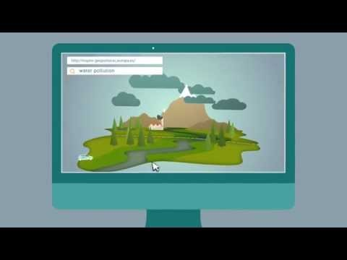
The INSPIRE Directive: a brief description (2min39)

Slide 3
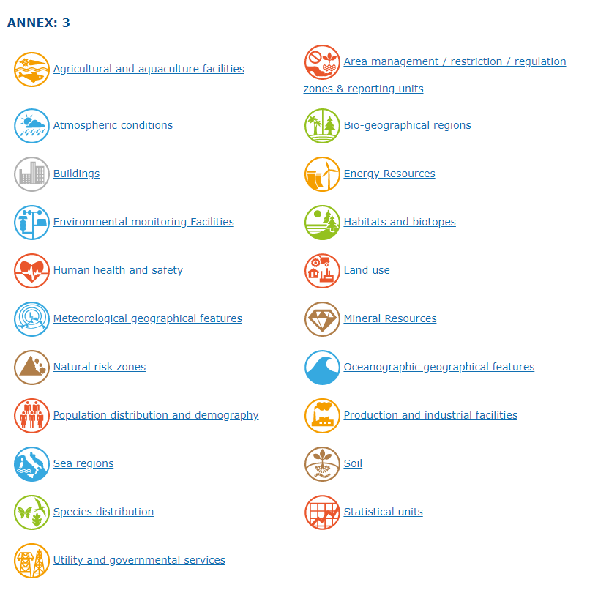
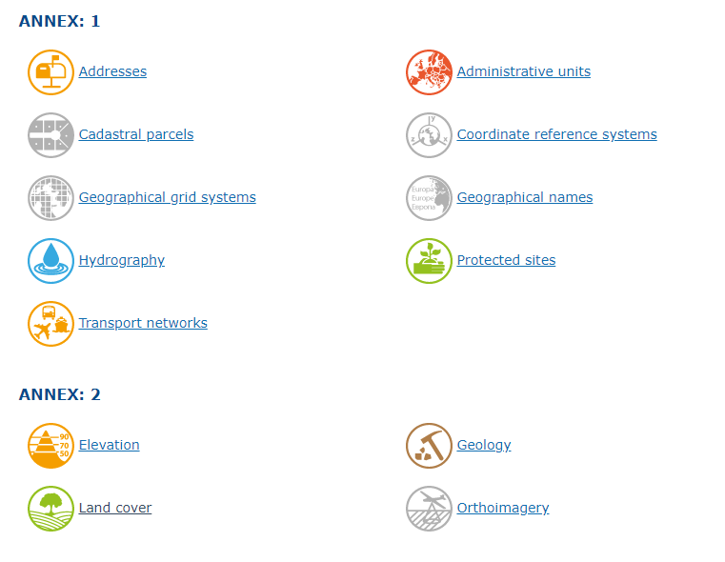
The 34 themes
Link with geotechnics

Slide 4
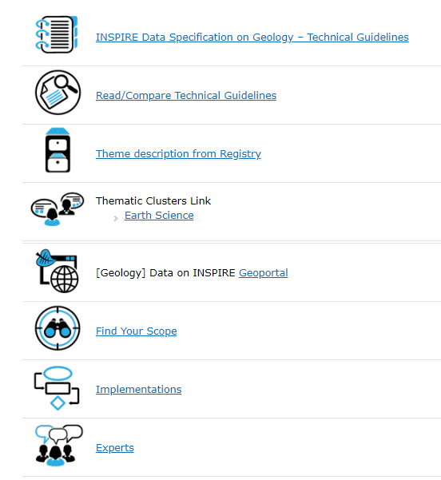
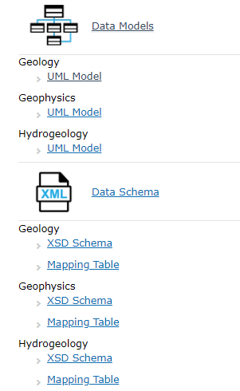

Example of the Geology Theme
Geology Theme
-
Geology
Geophysics
Hydrogeology

Slide 5
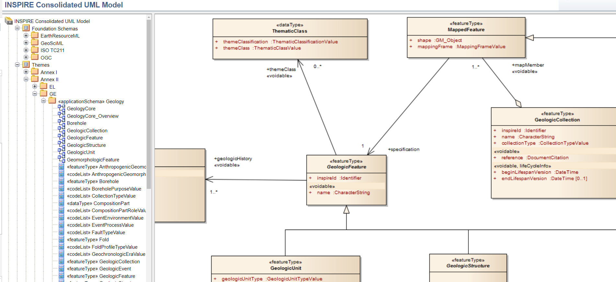
Extract of the Geology UML Model

Slide 6
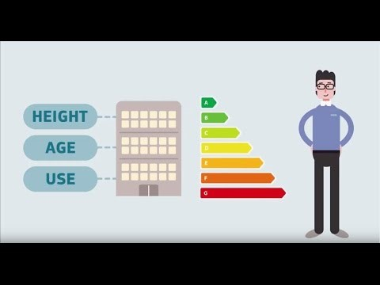
Making INSPIRE work for you! (1min53)

Slide 7
Conclusion
INSPIRE : An European Directive to promote data standardization and sharing of environmental data
Several themes that can be linked to geotechnics
Several models defined by experts
That have to be used by public data providers
But can also interest other data providers
Strong connection with OGC standards and working groups
Extension of those models is possible

